Slide 1
“Child of Okinawa” (1971) Higashi Mineo (1938-)
沖縄の少年
東峰夫

Slide 2
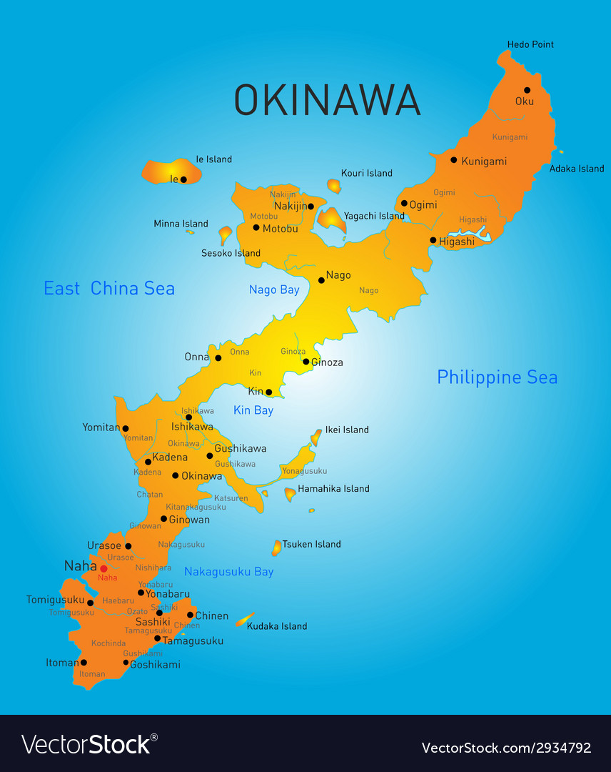
Map of Okinawa

Slide 3
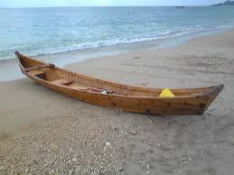
Sabani

Slide 4
Keywords
Language, familiar, intimate
irony
Dollar economy post-reversion, Koza
Saipan, Misato, Koza
Koza Uprising? (94)
Sabani
Mabui (spirit), onibi (will o’ the wisp)
Landscape & gender
patriarchy

Slide 5
Discussion Questions
What type of story is ”Child of Okinawa”? Is it a coming of age story? Is it protest literature? Is it an adventure story? Is it a ghost story?
How does “Child of Okinawa” differ in tone from “The Cocktail Party”? What accounts for this difference?
How does it differ from “The Wild Boar George Gunned Down”?
Compare and contrast Child of Okinawa and “Red Palm Leaves.”

